Slide 1
DATA
STRUCTURES

Slide 2
What is data structure ?
Data structure = Organized data + allowed operations
What is ADT?
Abstract data types or ADTs are a mathematical specification of a set of data and the set of operations that can be performed on the data.

Slide 3
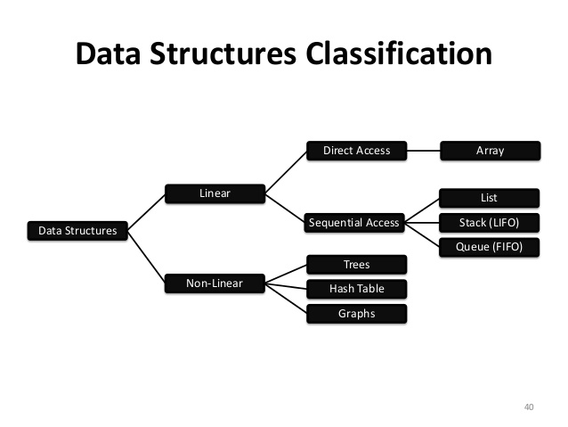

Slide 4
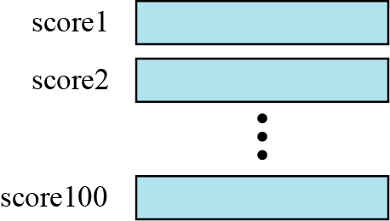
ARRAYS
Imagine that we have 100 scores. We need to read them, process them and print them. We must also keep these 100 scores in memory for the duration of the program. We can define a hundred variables, each with a different name, as shown in Figure
A hundred individual variables

Slide 5
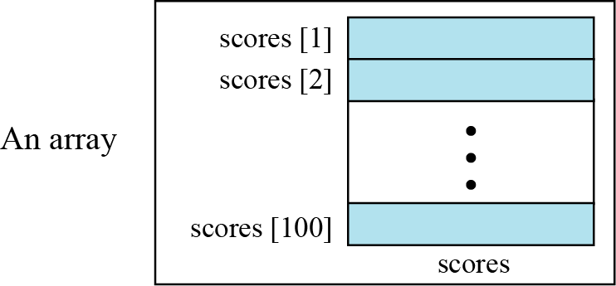
But having 100 different names creates other problems. We need 100 references to read them, 100 references to process them and 100 references to write them.
An array is a sequenced collection of elements, normally of the same data type, although some programming languages accept arrays in which elements are of different types. We can refer to the elements in the array as the first element, the second element and so forth, until we get to the last element.

Slide 6
Disadvantages:
Predetermining the size of the array is a must.
There is a chance of memory wastage or shortage.
Insertion and deletion is very slow.

Slide 7
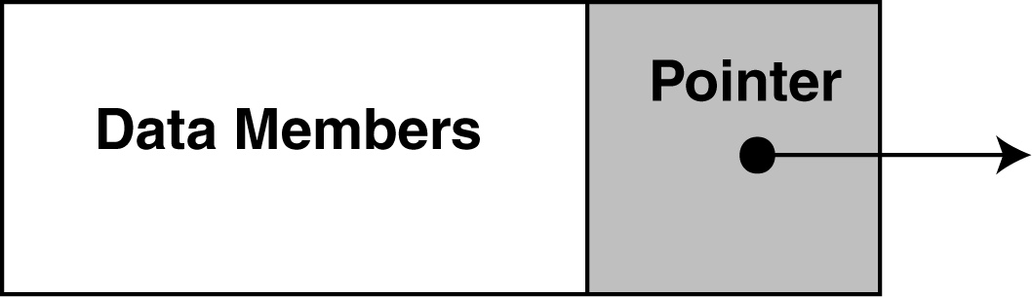
Linked list
Each node in a linked list contains one or more members that represent data.
In addition to the data, each node contains a pointer, which can point to another node.

Slide 8
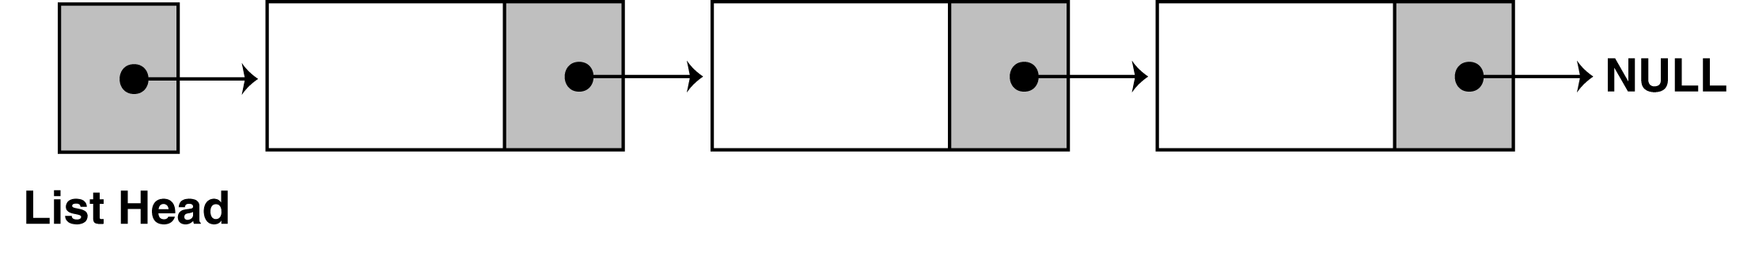
A linked list is called "linked" because each node in the series has a pointer that points to the next node in the list.

Slide 9
Doubly linked list
A doubly linked list provides a natural implementation of the List ADT
Nodes implement Position and store:
element
link to the previous node
link to the next node
Special trailer and header nodes
Header Trailer
prev
next
elem
node
elements

Slide 10
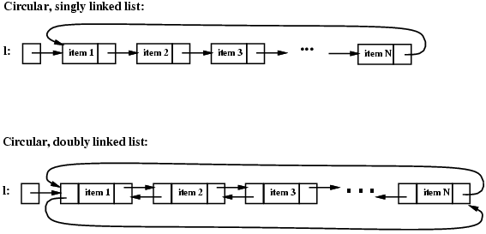
Circular linked list

Slide 11
stack
A stack is a data structure that stores data in such a way that the last piece of data stored, is the first one retrieved
also called last-in, first-out
Only access to the stack is the top element
consider trays in a cafeteria
to get the bottom tray out, you must first remove all of the elements above

Slide 12
Push
the operation to place a new item at the top of the stack
Pop
the operation to remove the next item from the top of the stack

Slide 13
M
C
C
C
R
push(M)
R
item = pop()
item = M
R
X
X
X
A
A
A

Slide 14
Application of Stacks - Evaluating Postfix Expressions
Expressions can also be represented using postfix notation - where an operator comes after its two operands or prefix notation – where an operator comes before its two operands.
Infix | Postfix | Prefix | Notes
A * B + C / D | A B * C D / + | + * A B / C D | multiply A and B,divide C by D,add the results
A * (B + C) /D | A B C + * D / | / * A + B C D | add B and C, multiply by A, divide by D
A * (B + C / D) | A B C D / + * | * A + B / C D | divide C by D, add B, multiply by A

Slide 15
Infix to Prefix conversion (manual)
An Infix to Prefix manual conversion algorithm is:
1. Completely parenthesize the infix expression according to order of priority you want.
2. Move each operator to its corresponding left parenthesis.
Remove all parentheses.
Examples:
3 + 4 * 5 (3 + (4 * 5) ) + 3 * 4 5
a / b ^ c – d * e – a * c ^ 3 ^ 4 - / a ^ b c - * d e * a ^ c ^ 3 4
( (a / (b ^ c)) – ( (d * e) – (a * (c ^ (3 ^ 4) ) ) ) )

Slide 16
Infix to Postfix conversion (manual)
An Infix to Postfix manual conversion algorithm is:
1. Completely parenthesize the infix expression according to order of priority you want.
2. Move each operator to its corresponding right parenthesis.
Remove all parentheses.
Examples:
3 + 4 * 5 (3 + (4 * 5) ) 3 4 5 * +
a / b ^ c – d * e – a * c ^ 3 ^ 4 a b c ^ / d e * a c 3 4 ^ ^ * - -

Slide 17
Queue
A queue is a waiting line
It’s in daily life:
A line of persons waiting to check out at a supermarket
A line of persons waiting to purchase a ticket for a film
Queue exhibits first-in-first-out (FIFO)

Slide 18
Unlike stacks in which elements are popped and pushed only at the ends of the list,
Collection of data elements:
items are removed from a queue at one end, called the FRONT of the queue;
and elements are added at the other end, called the BACK

Slide 19
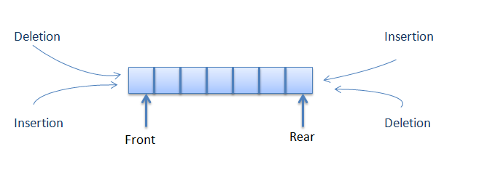
DOUBLE ENDED QUEUE

Slide 20
Trees
Tree
Nodes
Each node can have 0 or more children
A node can have at most one parent

Slide 21
Terminology
Root: node without parent (A)
Siblings: nodes share the same parent
Internal node: node with at least one child (A, B, C, F)
External node (leaf ): node without children (E, I, J, K, G, H, D)
Ancestors of a node: parent, grandparent, grand-grandparent, etc.
Descendant of a node: child, grandchild, grand-grandchild, etc.
Depth of a node: number of ancestors
Height of a tree: maximum depth of any node (3)
Degree of a node: the number of its children
Subtree: tree consisting of a node and its descendants
A
B
C
D
E
F
G
H
I
J
K

Slide 22
Trees Data Structures
Binary tree
Tree with 0–2 children per node
Tree
Binary Tree

Slide 23
Types of Binary Trees
Degenerate – only one child
Complete – always two children
Balanced – “mostly” two children
more formal definitions exist, above are intuitive ideas
Degenerate binary tree
Balanced binary tree
Complete binary tree

Slide 24
Binary Search Trees
Key property
Value at node
Smaller values in left subtree
Larger values in right subtree
Example
X > Y
X < Z
X
Y
Z

Slide 25
Binary Search Trees
Examples
5
10
10
2
45
5
30
5
45
30
2
25
45
2
25
30
10
25
Binary search trees
Not a binary search tree

Slide 26
Graph
A graph G consists of two sets
a finite, nonempty set of vertices V(G)
a finite, possible empty set of edges E(G)
G(V,E) represents a graph
An undirected graph is one in which the pair of vertices in a edge is unordered, (v0, v1) = (v1,v0)
A directed graph is one in which each edge is a directed pair of vertices, <v0, v1> != <v1,v0>

Slide 27
Examples for Graph
0
0
0
1
2
1
2
1
3
3
4
5
6
G1
2
G2
complete graph
incomplete graph
G3
V(G1)={0,1,2,3} E(G1)={(0,1),(0,2),(0,3),(1,2),(1,3),(2,3)}
V(G2)={0,1,2,3,4,5,6} E(G2)={(0,1),(0,2),(1,3),(1,4),(2,5),(2,6)}
V(G3)={0,1,2} E(G3)={<0,1>,<1,0>,<1,2>}
complete undirected graph: n(n-1)/2 edges
complete directed graph: n(n-1) edges

Slide 28
Difference between BFS and DFS
BFS starts traversal from the root node and then explore the search in the level by level manner i.e. as close as possible from the root node
DFS starts the traversal from the root node and explore the search as far as possible from the root node i.e. depth wise.

Slide 29
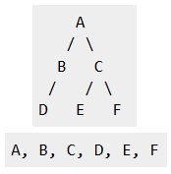
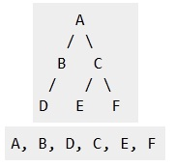

Slide 30

Hashing
Hashing is a technique where search time is independent of the number of items or elements. In this technique a hash function is used to generate an address from a key. The hash function takes a key as input and returns the hash value of that key which is used as an address index in the array.
We can write hash function as follows
h(k)=a;
Where h is hash function, k is the key, a is the hash value of the key.

Slide 31
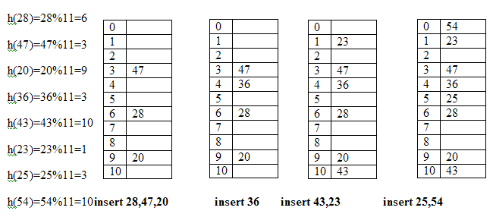

Slide 32
What is the simple difference between stack and queue type data structure
Stack operates in a Last In First Out (LIFO) fashion while Queue operates in a First In First Out fashion (FIFO).
Can you tell real life examples for stack and queue ?
Plates arranged one over the other in hotel is an example for stack. Plate that was placed last on top will be the first one to be removed from the stack.
Queue in billing section of stores is an example for queue.

